Slide 1

Radio Map Estimation
Presenter: Dong Yang
Computer Science
Georgia State University, Atlanta, GA, USA
Nov 5, 2024

Slide 2
Outline
Background
Technical challenges
Problem formulation
State-of-the-art methods
Our method

Slide 3







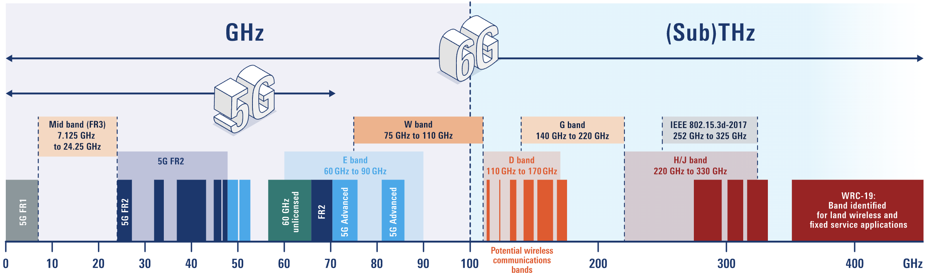
Background: Spectrum needs
5G → 6G: higher data rate, lower latency, larger capacity, ubiquitous connectivity
CDMA2000, WCDMA, TD-SCDMA
LTE,
LTE-A
New Radio
6G
THz, ISAC, AI
AMPS, NMT, TACS
GSM, GPRS, Edge
3G
4G
5G
1G
2G
>1 Tbps
10-100us
300 Mbps
10ms
20 Gbps
1ms
50 Kbps
300ms
60 Mbps
100ms
2.4 Kbps
~1980
~1990
~2000
~2010
~2020
~2030

Slide 4

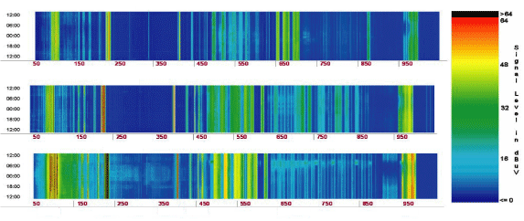
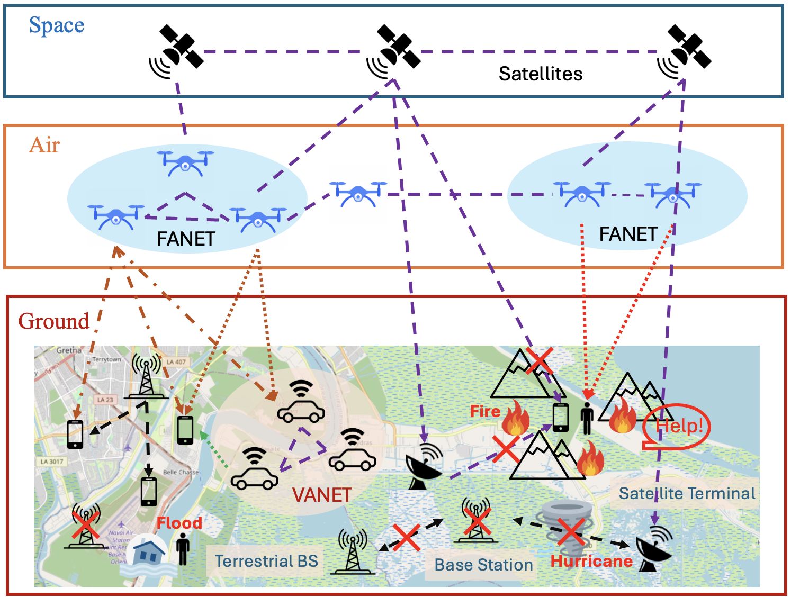
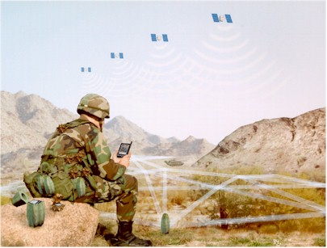
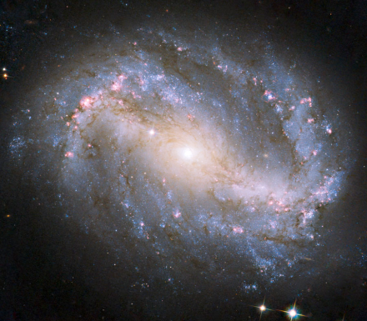

Background: Needs for spectrum monitoring
Spectrum holes
Spectrum
cognitive radio (CR)
dynamic spectrum access
tactical networks
passive radio coexistence
self-organizing, path planning
Notes:
Space-Air-Ground Integrated Network
Wireless Network Management
UAV Path Planning
Outage Detection
Device Self-Organization

Slide 5
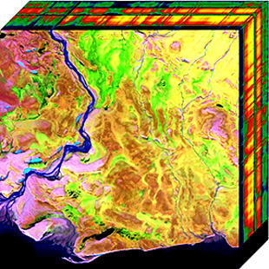
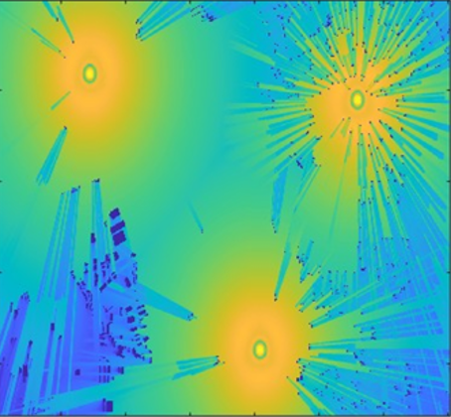
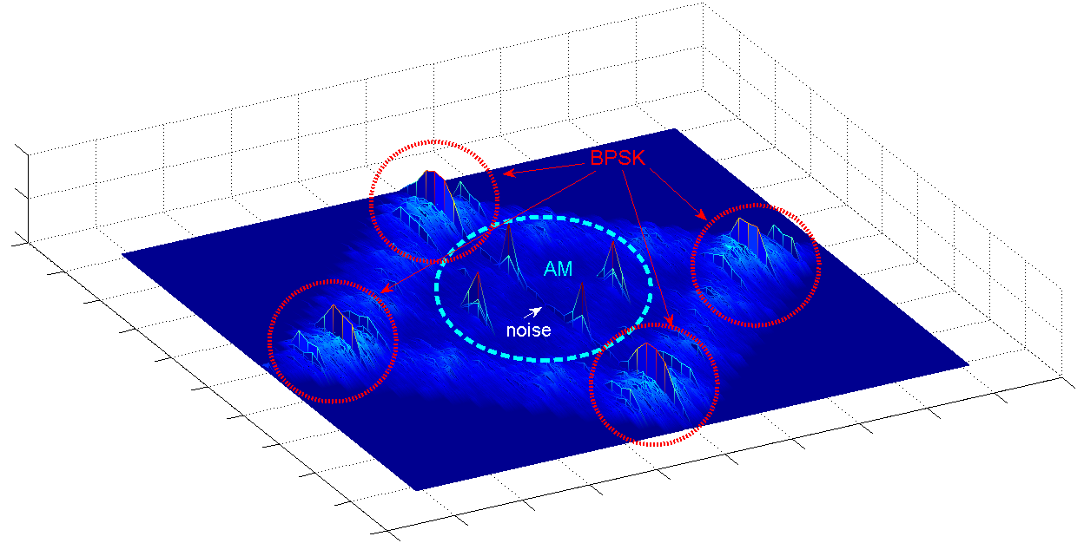
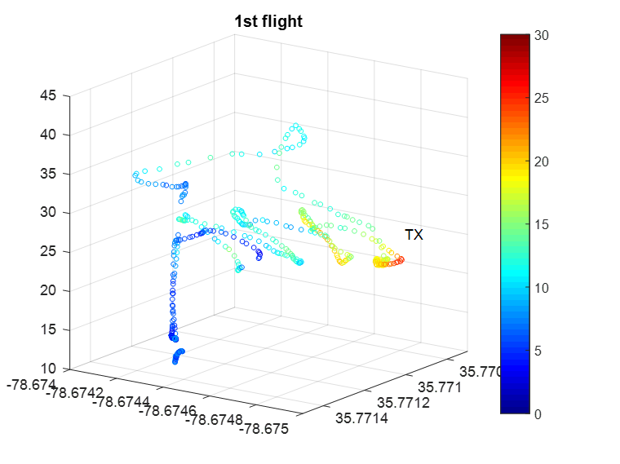
Challenges: Scenarios of spectrum monitoring
(a) Spectrum occupancy (state detection)
(c) Spectrum cartography
(radio map estimation)
f
2-D Spatial
(b) Cyclic spectrum
(feature detection/classification)
+ Freq./time
S_{x}(f ;α)
3-D Spatial
f
α
Main challenge: high dimensionality
Notes:
For sample collection

Slide 6
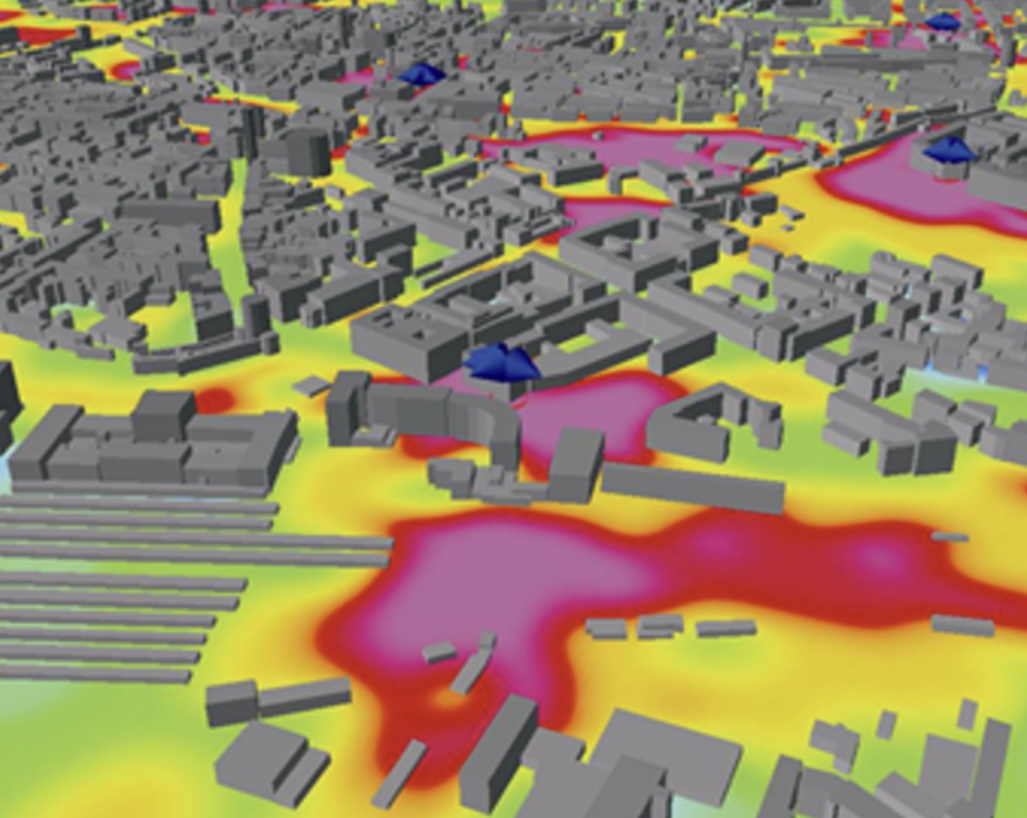
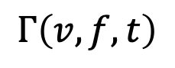
What is radio map
Radio map: radio power as a function of location 𝑣, frequency 𝑓 and/or with time 𝑡 denoted by
$$Γ\left(v,f,t\right)$$
2-D Spatial Space
3-D Spatial Space
Frequency
Time Slots
Radiomap: https://web.altair.com/winprop-telecom
2-D Spatial Space
2-D Spatial Space
useful for network management, coverage planning, spectrum allocation

Slide 7

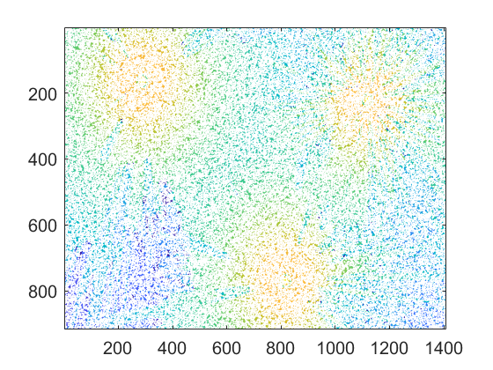


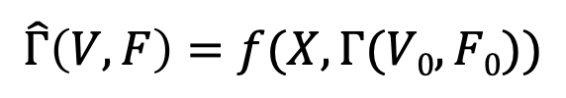

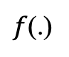

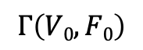
Problem formulation: Radio map estimation (RME)
Learning-based (centralized) RME ^{Romero –Kim’2022}
$$\min_{w}{\frac{1}{T}\sum_{t=1}^{T}{{\left\|Γ(V,F)−\hat{Γ}(V,F)\right\|}_{F}^{2}}}$$
$$\hat{Γ}\left(V,F\right)=f(X,Γ(V0,F0))$$
Γ : ground-truth radio map
$$X$$
$$Γ\left(V0,F0\right)$$
$f$(.)
$$\hat{Γ}\left(V,F\right)$$
Building info
sparse observations
mapping (e.g. DNN)
full-scale RME
Measurements: sparse samples collected by terminal devices/sensors
No channel information required; whereas ray tracing needs channel models
RUs make partial observations of the global radio map

Slide 8
Roadmap estimation: SP versus ML
RF environment: measurements = physical model h(spectrum state)
Monitoring task: spectrum state = f (measurements) = h⁻¹(・)
Model-based signal processing (SP)
from sparse data
Data-driven machine learning (ML)
from abundant data
Cooperative spectrum monitoring over distributed networks
 | SP | ML
Physical model | Assumed known | Unknown
Training | Parameters estimation | Data driven
Design variable | Spectrum state | f (.): model parameters
Cooperation | No common spectrum | No common model
Notes:
Infer spectrum from measurements, which result from the spectrum state through physical models for the channels and transceivers

Slide 9
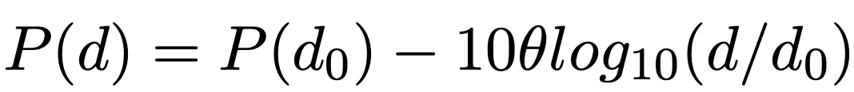

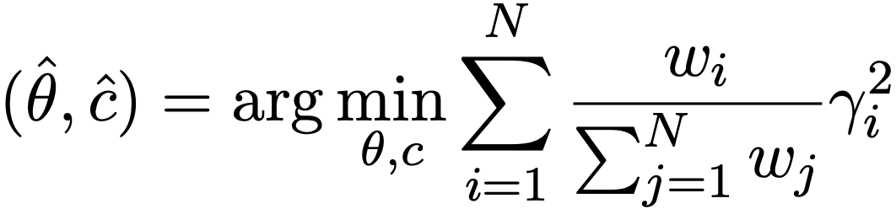
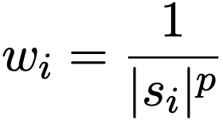

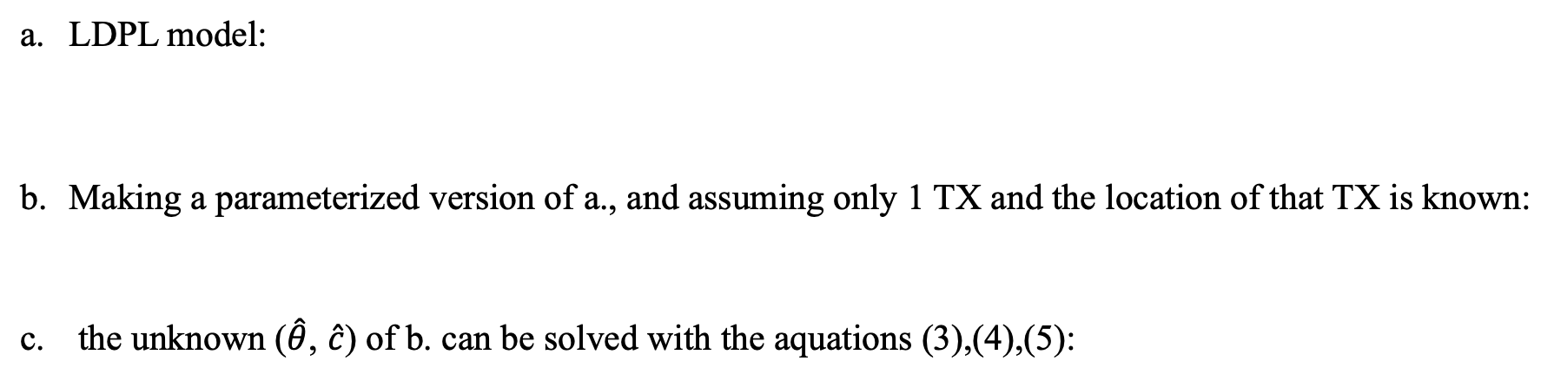

Model-based SP method: LDPL^{[1]}
LDPL ^{[1]}: Using a Log Distance Path Loss Model based Interpolation method
LDPL model:
Making a parameterized version of a., and assuming only 1 TX and the location of that TX is known:
the unknown ($\hat{θ}$, $\hat{c}$) of b. can be solved with the aquations (3),(4),(5):
(1)
(2)
(3)
(4) (5)
where P(d), $θ$, P(d₀) denote an estimated RSS at distance d from TX to point, path loss, observed RSS at reference distance d₀
[1]
M. Lee and D. Han, ”Voronoi tessellation based interpolation method for wi-fi radio map construction,” in IEEE Communications Letters, vol. 16, no. 3, pp. 404-407, Mar. 2012.
Notes:
r_i measures i-th error between observed and pred. w_i is a weighting factor for r_i. let r_i have a different level of importance in the sum.
s_i​ represents the RSS at observed point
Locations with a high RSS will have a smaller weight w_i, making them less influential in the optimization.
The parameter p controls the sensitivity of this weighting. Higher p values would give less weight to locations with strong signals

Slide 10
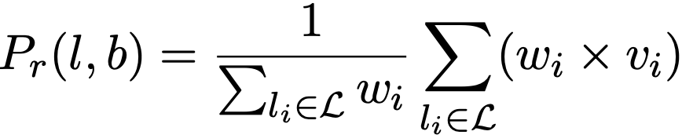
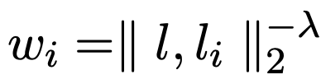
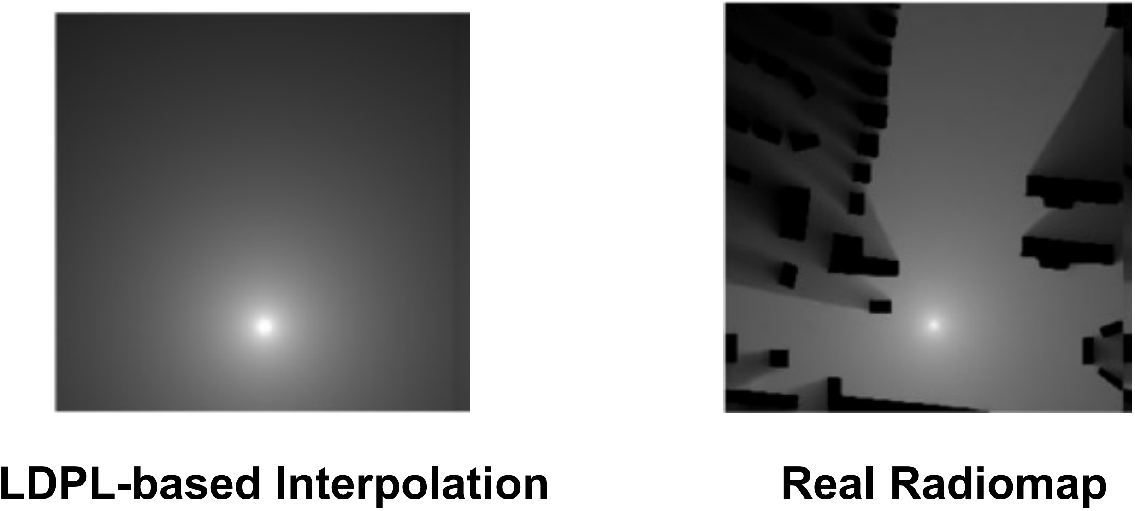


Model-based SP method: IDW^{[2]}
IDW ^{[2]}: Using Inverse Weight Model based Interpolation method
Estimated RSS are calculated by the sum of observed RSS multiplied by a normalized weight :
Weight w_{i} is calculated by Euclidean distance:
(1)
(2)
where l_{i} is the i-th observed point, v_{i} is the observed RSS from TX at the observed point $θ$
where l is the location of estimated point, $λ$ is system parameter (typically =0.01)
Limitation of Model-based SP method:
Not capturing shadowing effects (buildings)
S. -P. Kuo and Y. -C. Tseng, “Discriminant minimization search for largescale rf-based localization systems,” in IEEE Transactions on Mobile Computing, vol. 10, no. 2, pp. 291-304, Feb. 2011.
[2]

Slide 11
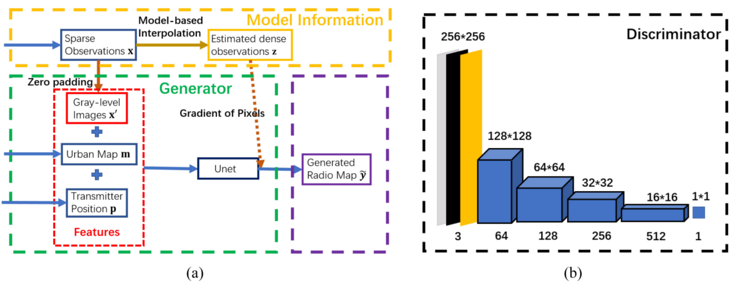
Generative AI with Physics Loss for RME^{[3]}
Unlike Image Recovery
Spectrum coverage follows physical radio propagation principles.
RME-GAN ^{[3]}: Customize the physical loss function of conditional GAN for radiomap estimation
[3]
S. Zhang, A. Wijesinghe, and Z. Ding, “Rme-gan: A learning framework for radio map estimation based on conditional generative adversarial network,” IEEE Internet of Things Journal, vol. 10, no. 20, pp. 18 016–18 027, 2023

Slide 12
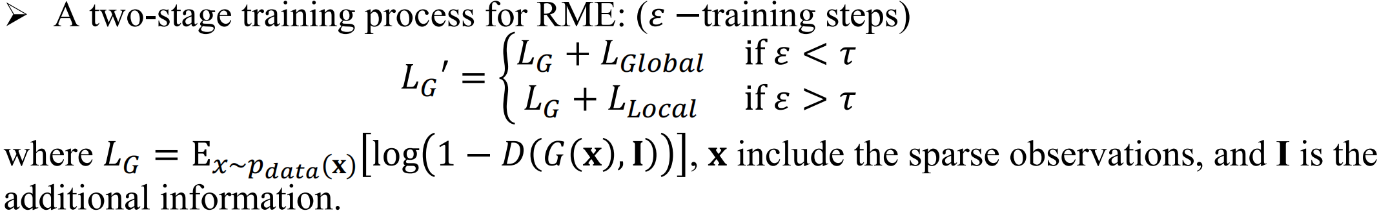
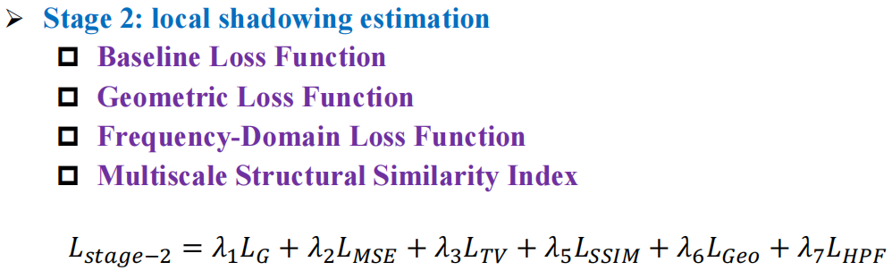
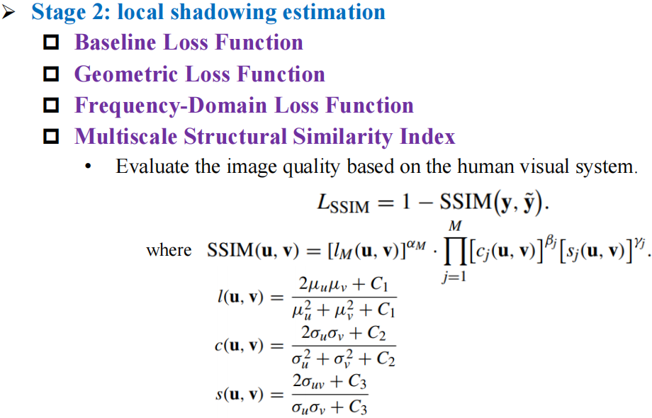
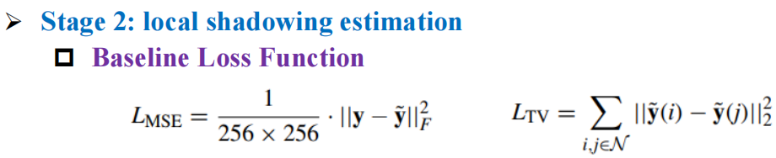
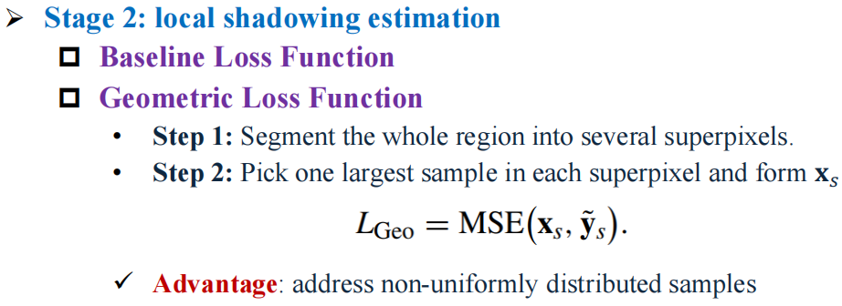
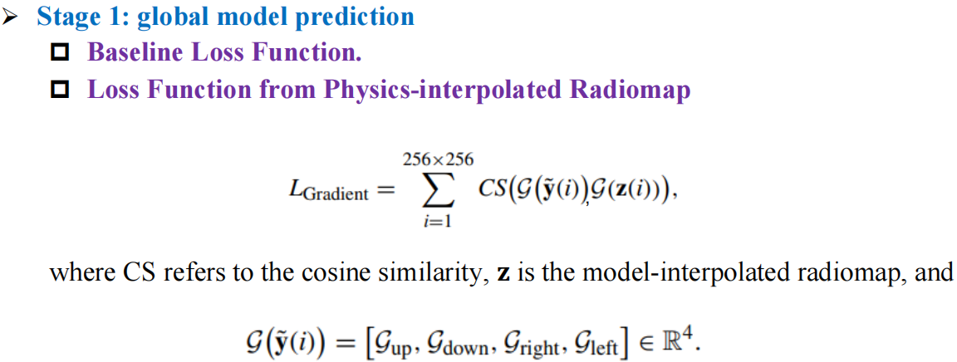
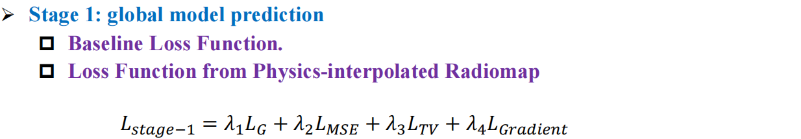
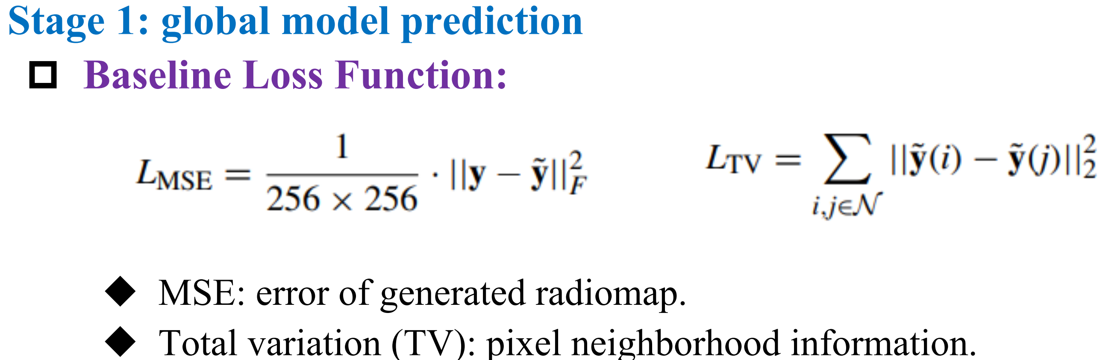
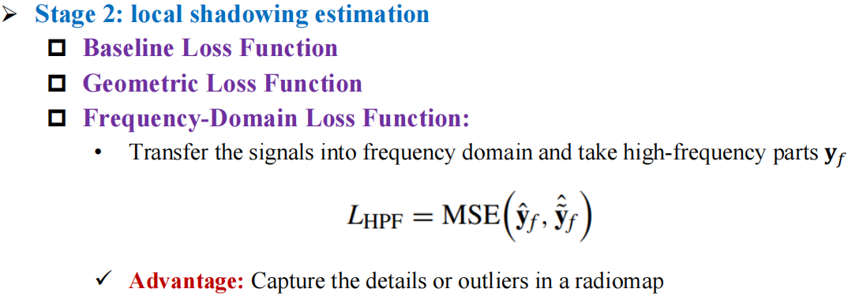
Overall Framework of RME-GAN
[3]
S. Zhang, A. Wijesinghe, and Z. Ding, “Rme-gan: A learning framework for radio map estimation based on conditional generative adversarial network,” IEEE Internet of Things Journal, vol. 10, no. 20, pp. 18 016–18 027, 2023

Slide 13
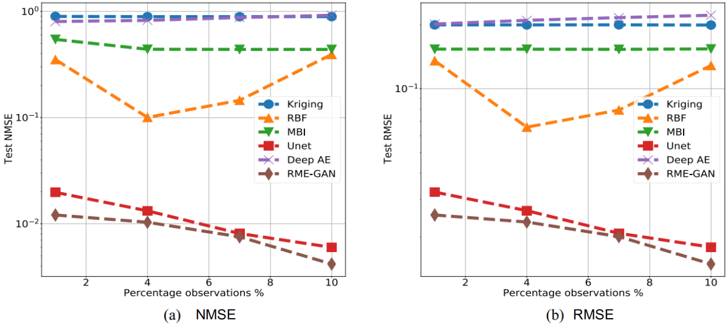
Simulation Results
[3]
S. Zhang, A. Wijesinghe, and Z. Ding, “Rme-gan: A learning framework for radio map estimation based on conditional generative adversarial network,” IEEE Internet of Things Journal, vol. 10, no. 20, pp. 18 016–18 027, 2023

Slide 14
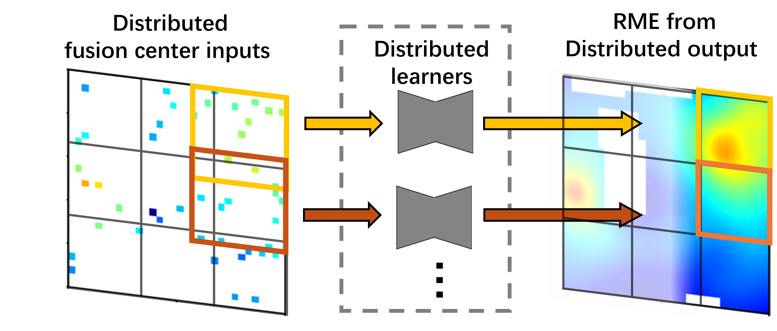
Federated Learning for distributed RME ^{[4]}
Local input:
Local sensor sparse RSS
Sensor mask
City map
Homogeneous local tasks: RME given sparse sensor data and building info.
Allow overlapping between adjacent regions.
Combine trimmed local outputs for global RME.
[4]
Weishan Zhang, Yue Wang, Lingjia Liu, Zhi Tian, “FedRME: Federated Learning for Enhanced Distributed Radiomap Estimation,” in 2024 IEEE 100th Vehicular Technology Conference (VTC2024-fall),2024. （Received）

Slide 15
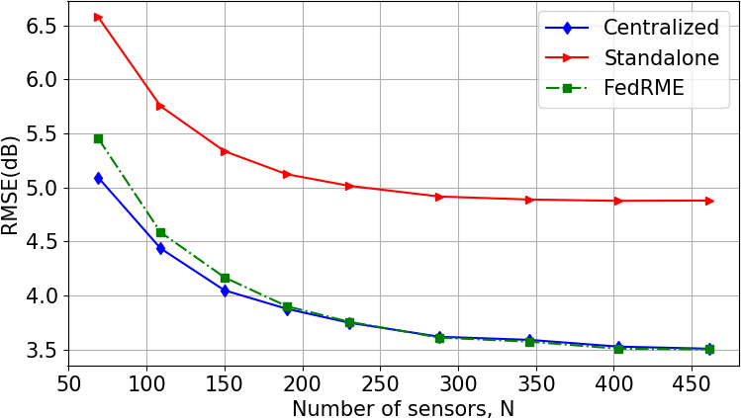
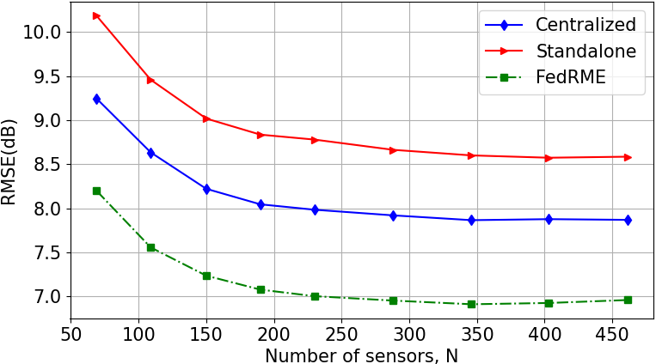
Simulation Results
RMSE vs sensor volume (1000 testing instances)
Trained with sufficient training data (20k training)
Trained with limited training data (1k training)
Comparable RMSE to centralized learning
Outperforming the standalone method.
Apparently outperforms all baselines

Slide 16
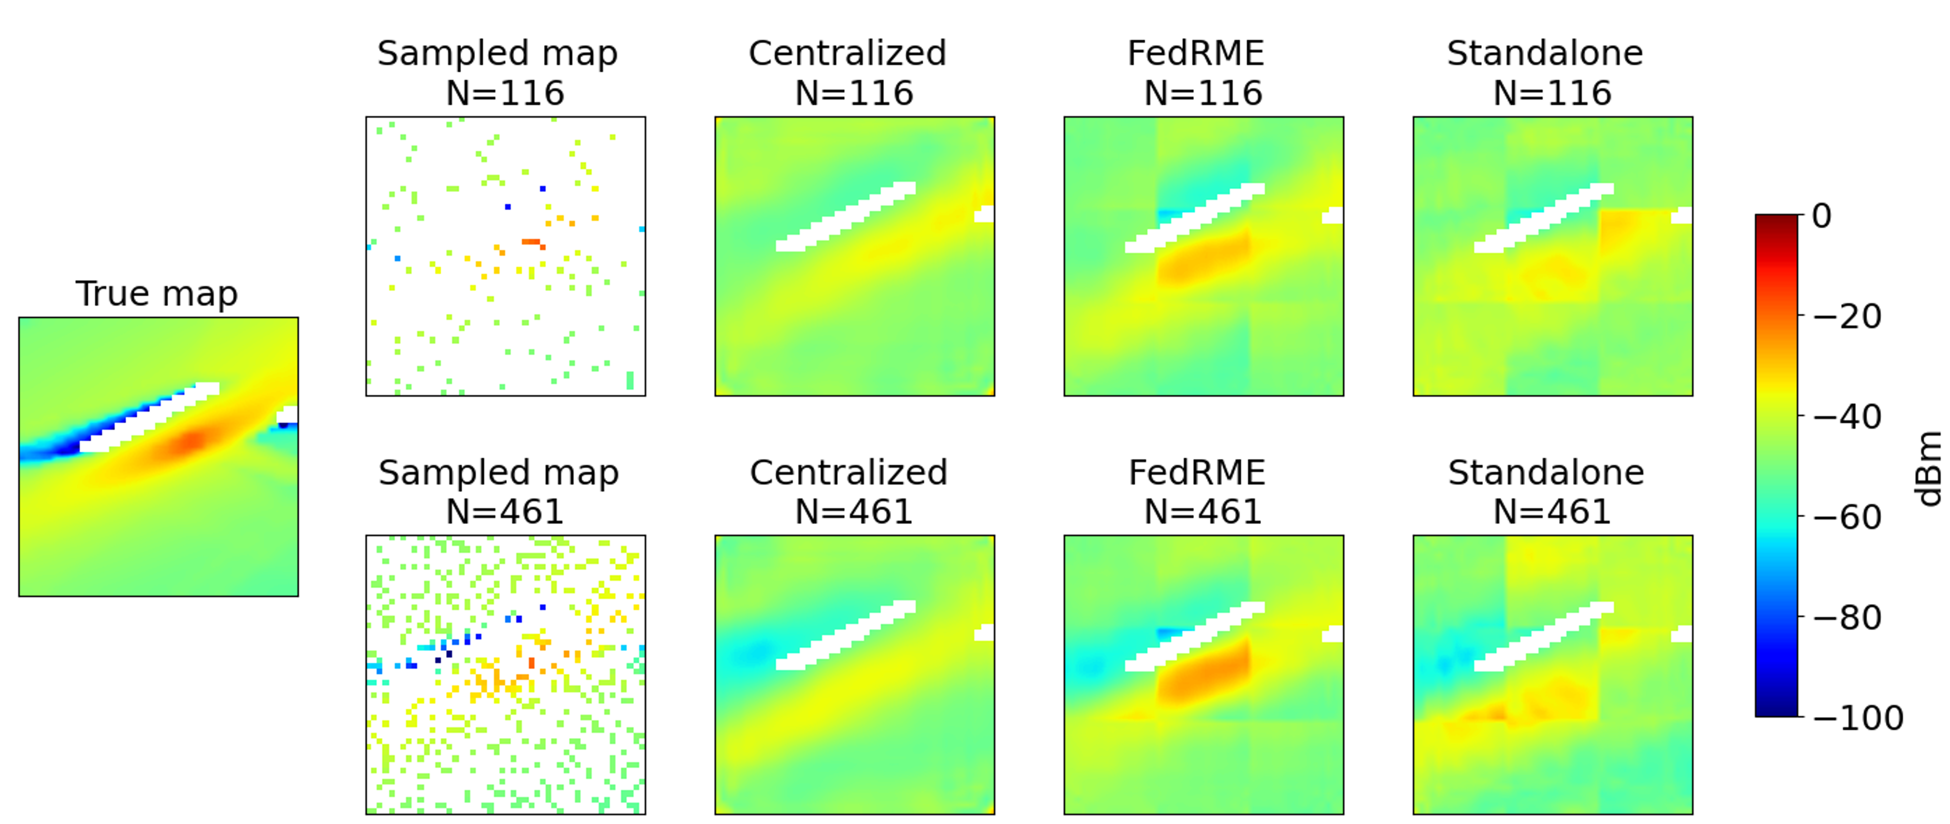
Simulation
Example output of different RME methods (1k training data):
Fewer
sensors
More
sensors
FedRME gives more reasonable estimates, especially around the Tx
Notes:
Due to overfitting, cannot find source
Stdaln:

Slide 17
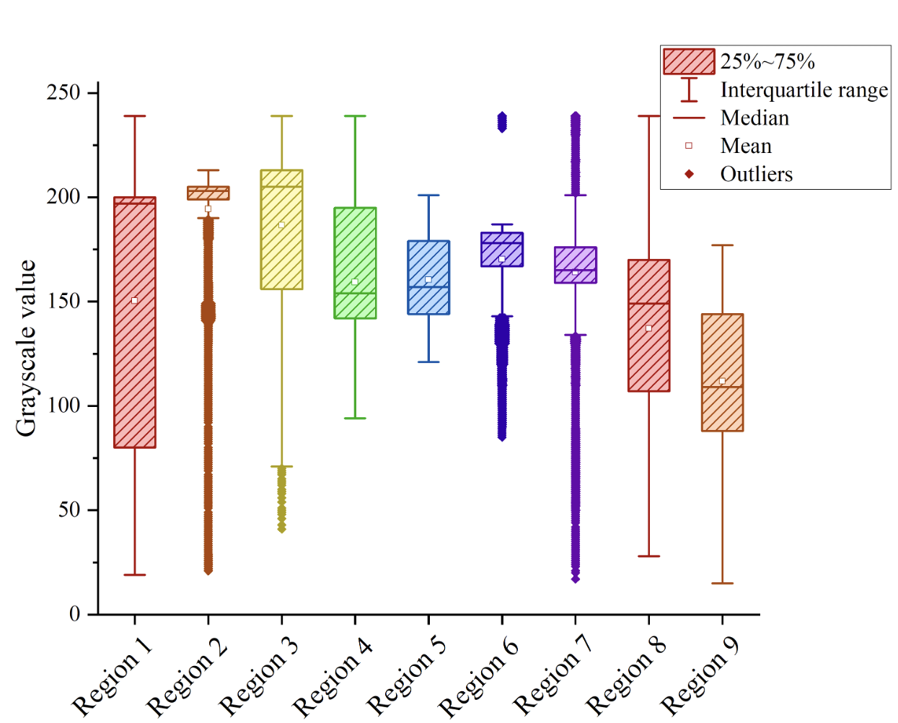

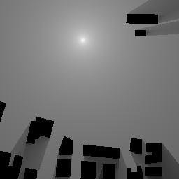
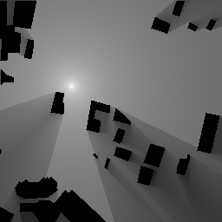
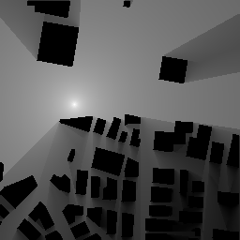
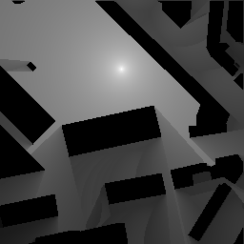

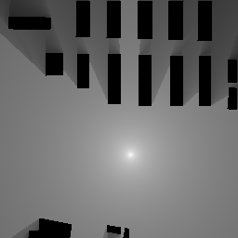
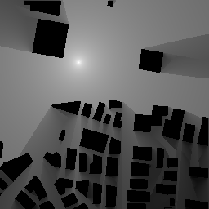

Physics-inspired distributed RME: Challenge
Challenge: Heterogeneous local tasks: RME only given sparse sensor data and TX location.

Slide 18
Thank You!

